Slide 1





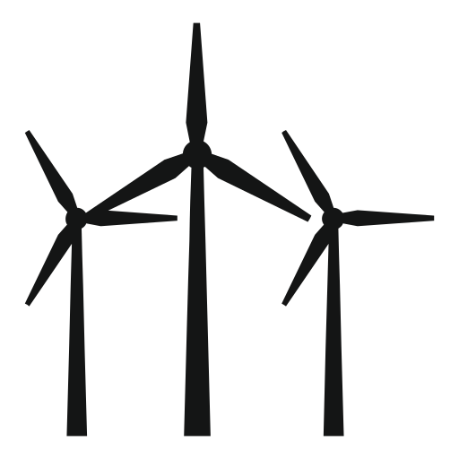





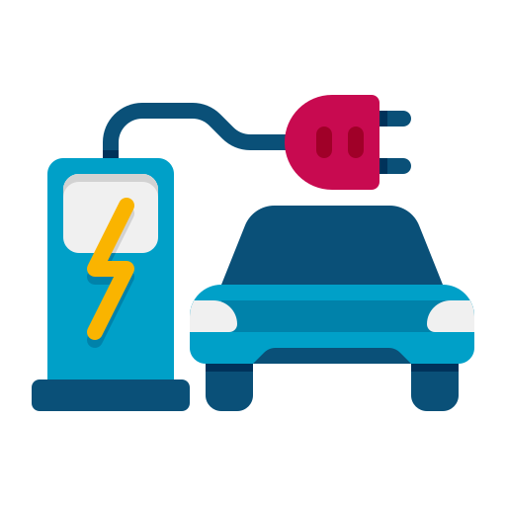

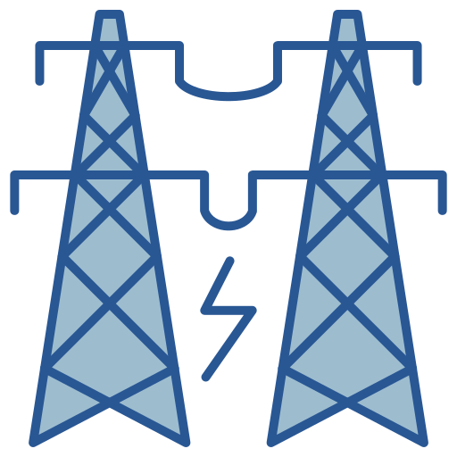

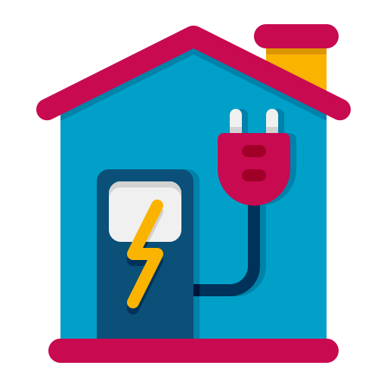



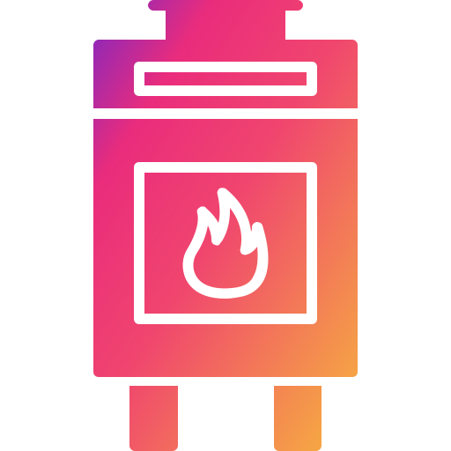
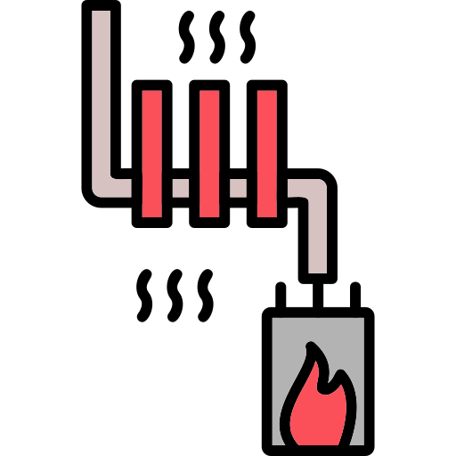
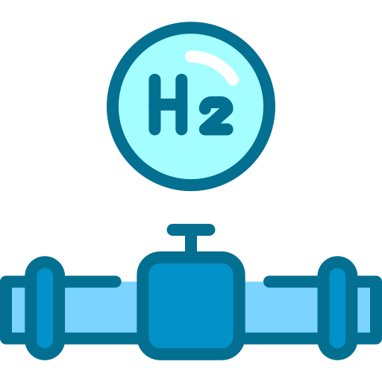



a
b
2015
2017
2019
c
Power (GW)
Dunkelflaute
Power (GW)
Power (GW)
Peak shaving
Day1
Day7
Day12
Down
Up
Forecast errors
0
6
12
18
24
0
6
12
18
24
Power balancing
Load ramping
Congestion management
Gas
Wind farm
Hydropower
Solar farm
Charging station
Natural gas
Power network
Heat pump
Green hydrogen
End-user
Gas network
District heat
Frequency response
Voltage regulation
Resilience enhancement
d
Instant of disturbance
e
Overvoltage
Peaks
f
Occurrence
End
+15%
Frequency (Hz)
Nadir increase
Voltage (Volt)
Normal
Performance
Failure occurs
RoCoF increase
Undervoltage
-15%
Grid restoration
Time (sec.)
Time (sec.)
04-28 12:33
04-29 0:40

Slide 2

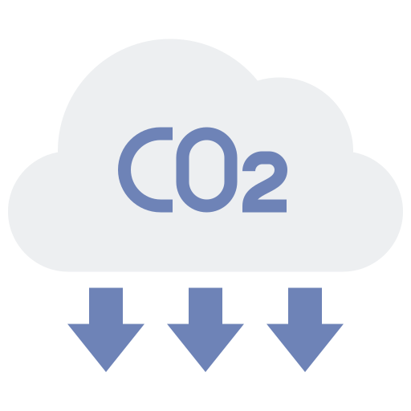





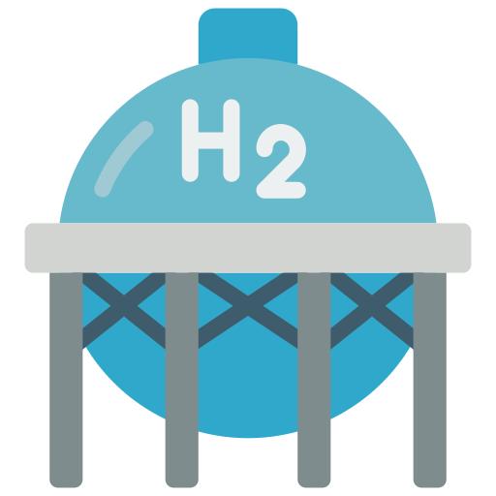



a
Gas
Biomass
Nuclear
b
Line capacity
c
Storage+
Storage-
Power (GW)
Power (GW)
Flexibility availability
Power (GW)
Solar & Wind
Power flow
Wind
Day1
Day2
Day3
Day4
0
6
12
18
24
Day1
Day2
Day3
Clean dispatchable generation
Grid interconnector
Large-scale electricity storage
Gas
Wind farm
Interconnector
Carbon capture
Smart charging
Solar farm
Hydropower
Pumped
hydro storage
Clean natural gas
Demand response
Flexible nuclear
Power network
Heat pump
Battery storage
Biomass
Power-to-X
H2 Storage
Combined
heat and power
District heat
Thermal
energy storage
Gas network
Linepack storage
Long duration energy storage
Combine heat and power
Demand-side response
d
Shift
e
Heat
f
V2G
Power (GW)
Excess
Load duration
Demand
Charging
Demand
Shortage
H2
Load (%)
Baseload
Power (kW)
Solar
Solar power
Loss
Elec.
Hours
(year)
Arrive home
Winter
Summer
Winter
6
12
18
24
6

Slide 3


a
Space
b
Duration
International
Interconnector
year
Interconnector
Hydropower
SMR
P2X
National
Linepack
PHS
month
Regional
SMR
RNG
day
Biomass
Linepack
BESS
Hydropower
CAES/LAES
Biomass
EV
District
heat
Local
P2X
District heat
hour
ICDR
RNG
CAES/LAES
EV
ICDR
BESS
Smart appliance
PHS
Domestic
Smart appliance
Size
min
Speed
kW
MW
GW
ms
sec
min
hour
c
Supply-side resources
Demand-side enablers
Multi-vector integration
Most promising
Hydropower
RNG
SMR
Biomass
BESS
PHS
CAES/LAES
Interconnector
Smart appliance
ICDR
EV
P2X
Linepack
District heat
Contributing
Irrelevant
technology
Power balancing
Load ramping
Congestion management
Frequency response
Voltage regulation
Resilience enhancement
need

Slide 4









a
b
c
d
e
f
g
h
1st
2nd
3rd

Slide 6
Technology | Response time | Duration | Scale | Typical size | Key functions | Maturity
Hydropower (reservoir & run-of-river) | Seconds–minutes | Hours–months | Regional–national | 10 MW – 10+ GW | Fast ramping, inertia, seasonal balancing, black start | Mature
Clean natural gas (with CCS or H₂ blends) | Minutes | Hours–days | Regional–national | 100 MW – 1 GW+ | Dispatchable capacity, adequacy, reliability | Mature–transition
Flexible nuclear (incl. SMRs) | Minutes–hours | Days–months | National | 50 MW – 1.2 GW (SMRs ~50–300 MW) | Firm low-carbon capacity, load following, cogeneration | Emerging–mature
Biomass | Minutes–hours | Hours–days | Local–regional–national | 10 MW – 500 MW | Dispatchable renewable generation, adequacy | Mature
Battery energy storage (BESS) | Milliseconds | Minutes–hours | Domestic–national | kW (household), 1–100+ MW (utility) | Frequency control, peak shaving, fast balancing | Mature
Pumped hydro storage (PHS) | Minutes | 6–20 hours | Regional–national | 100 MW – 3 GW+ | Long-duration storage, peak shifting, adequacy | Mature
Compressed/liquid air storage (CAES/LAES) | Minutes–hours | 4–100+ hours | Regional–national | 50 MW – 300 MW (CAES); 5–50 MW (LAES demos) | Long-duration storage, backup, adequacy | Demo–early commercial
Grid interconnectors | Seconds–minutes | Continuous | National–international | 100 MW – 2 GW per link | Geographic balancing, adequacy, resilience | Mature
Domestic smart appliances | Sub-seconds–minutes | Minutes–hours | Domestic | 0.1–5 kW per device | Demand shifting, peak shaving, ancillary services | Emerging–scaling
Industrial & commercial demand response (ICDR) | Seconds–minutes | Minutes–hours | Local–regional–national | 100 kW – 100+ MW (aggregated) | Load curtailment, balancing, adequacy | Mature in some regions
Smart/bidirectional EV charging | Seconds–minutes | Hours–days | Domestic–local–regional | 3–22 kW (AC); 50–350 kW (DC fast chargers); aggregated → 100s MW | Vehicle-to-grid, peak shaving, balancing | Emerging–scaling
Power-to-X (hydrogen, fuels, chemicals) | Minutes–hours | Days–months | Regional–national | 1 MW – 100+ MW today; GW-scale planned | Sector coupling, long-term storage, decarbonization of hard-to-abate sectors | Demo–early commercial
Gas networks & linepack storage | Minutes–hours | Days–weeks | Regional–national | 100s MW – multi-GW equivalent storage | Multi-day storage, sector coupling, adequacy | Mature in NG, emerging in H₂
District heating with TES | Minutes–hours | Hours–days | Local–regional | 1–500 MWth (seasonal TES up to GWhth) | Load shifting, sector coupling (heat–electricity) | Mature in Nordics, emerging elsewhere

Slide 7
Technology | Power balancing | Load ramping | Congestion management | Frequency response | Voltage regulation | Resilience enhancement
Hydropower | ● | ● | ○ | ● | ○ | ●
Clean natural gas (with CCS/H₂ blends) | ● | ● | ○ | ○ | ○ | ●
Flexible nuclear (incl. SMRs) | ○ | ● | ○ | ○ | ○ | ●
Biomass | ○ | ● | ○ | ○ | ○ | ●
Battery energy storage (BESS) | ● | ○ | ○ | ● | ● | ○
Pumped hydro storage (PHS) | ● | ● | ○ | ○ | ○ | ●
CAES / LAES | ● | ● | ○ | ○ | ○ | ●
Grid interconnectors | ● | ○ | ● | ○ | ○ | ●
Domestic smart appliances | ○ | ○ | ○ | ● | ○ | ○
Industrial & commercial demand response (ICDR) | ● | ○ | ○ | ○ | ○ | ○
Smart / bidirectional EV charging | ● | ○ | ○ | ● | ○ | ○
Power-to-X (P2X) | ○ | ● | ○ | – | – | ●
Gas networks & linepack | ○ | ● | ○ | – | – | ●
District heating with TES | ○ | ● | ○ | – | – | ●

Slide 8

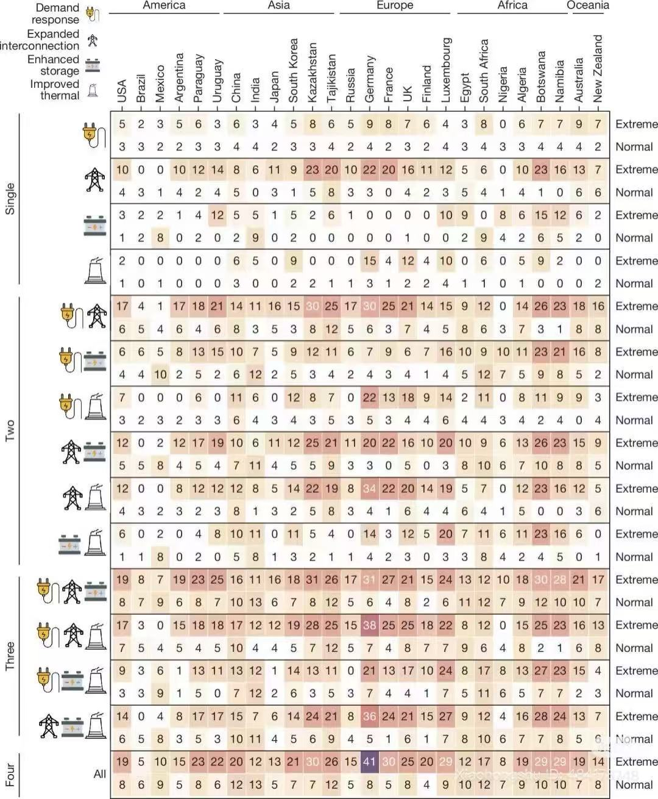

Slide 9
a
2015
2017
2019
c
Power (GW)
Down
Up
Power (GW)
Peak shaving
0
6
12
18
24
0
6
12
18
24
Clean dispatchable generation
Thermal energy storage
a
b
2015
2017
2019
c
Power (GW)
Dunkelflaute
Power (GW)
Power (GW)
Peak shaving
Day1
Day7
Day12
Down
Up
Imbalances
0
6
12
18
24
0
6
12
18
24
Large-scale electricity storage
Grid interconnector
Demand-side flexibility
Gas
Wind farm
Interconnector
Carbon capture
Smart charging
Solar farm
Hydropower
Pumped
hydro storage
Clean natural gas
Flexible nuclear
Power network
Heat pump
Demand response
Battery storage
Biomass
Power-to-X
H2 Storage
Combined
heat and power
District heat
Thermal
energy storage
Gas network
Linepack storage
Power-to-hydrogen
Combine heat and power
Linkpack storage
d
Instant of disturbance
e
Overvoltage
Peaks
f
Occurrence
End
+15%
Failure occurs
Grid restoration
Frequency (Hz)
Nadir increase
Voltage (Volt)
Normal
Performance
ROCOF increase
Undervoltage
-15%
Derating
Time (sec.)
Time (sec.)
t1
t2
t3
t4

Slide 10
a
Gas
Biomass
Nuclear
b
Line capacity
c
Storage+
Storage-
Power (GW)
Power (GW)
Flexibility availability
Power (GW)
Solar & Wind
Power flow
Wind
Day1
Day2
Day3
Day4
0
6
12
18
24
Day1
Day2
Day3
Clean dispatchable generation
Grid interconnector
Large-scale electricity storage
Gas
Wind farm
Interconnector
Carbon capture
Smart charging
Solar farm
Hydropower
Pumped
hydro storage
Clean natural gas
Demand response
Flexible nuclear
Power network
Heat pump
Battery storage
Biomass
Power-to-X
H2 Storage
Combined
heat and power
District heat
Thermal
energy storage
Gas network
Linepack storage
Long duration energy storage
Combine heat and power
Demand-side response
d
Shift
e
Heat
f
V2G
Power (GW)
Excess
Load duration
Demand
Charging
Demand
Shortage
H2
Load (%)
Baseload
Power (kW)
Solar
Solar power
Loss
Elec.
Hours
(year)
Arrive home
Winter
Summer
Winter
6
12
18
24
6

Slide 11
a
2015
2017
2019
c
Power (GW)
Down
Up
Power (GW)
Peak shaving
0
6
12
18
24
0
6
12
18
24
Clean dispatchable generation
Thermal energy storage
a
b
2015
2017
2019
c
Power (GW)
Dunkelflaute
Power (GW)
Power (GW)
Peak shaving
Day1
Day7
Day12
Down
Up
Imbalances
0
6
12
18
24
0
6
12
18
24
Large-scale electricity storage
Grid interconnector
Demand-side flexibility
Gas
Wind farm
Interconnector
Carbon capture
Smart charging
Solar farm
Hydropower
Pumped
hydro storage
Clean natural gas
Flexible nuclear
Power network
Heat pump
Demand response
Battery storage
Biomass
Power-to-X
H2 Storage
Combined
heat and power
District heat
Thermal
energy storage
Gas network
Linepack storage
Power-to-hydrogen
Combine heat and power
Linkpack storage
d
Instant of disturbance
e
Overvoltage
Peaks
f
Occurrence
End
+15%
Failure occurs
Grid restoration
Frequency (Hz)
Nadir increase
Voltage (Volt)
Normal
Performance
ROCOF increase
Undervoltage
-15%
Derating
Time (sec.)
Time (sec.)
t1
t2
t3
t4

Slide 12
a
b
2015
2017
2019
c
Power (GW)
Dunkelflaute
Power (GW)
Power (GW)
Peak shaving
Day1
Day7
Day12
Down
Up
Forecast errors
0
6
12
18
24
0
6
12
18
24
Power balancing
Load ramping
Congestion management
Gas
Wind farm
Hydropower
Solar farm
Charging station
End-user
Natural gas
Power network
Heat pump
Green hydrogen
Gas network
District heat
Frequency response
Voltage regulation
Resilience enhancement
d
Instant of disturbance
e
Overvoltage
Peaks
f
Occurrence
End
+15%
Failure occurs
Grid restoration
Frequency (Hz)
Nadir increase
Voltage (Volt)
Normal
Performance
RoCoF increase
Undervoltage
-15%
Derating
Time (sec.)
Time (sec.)
t1
t2
t3
t4

Slide 13
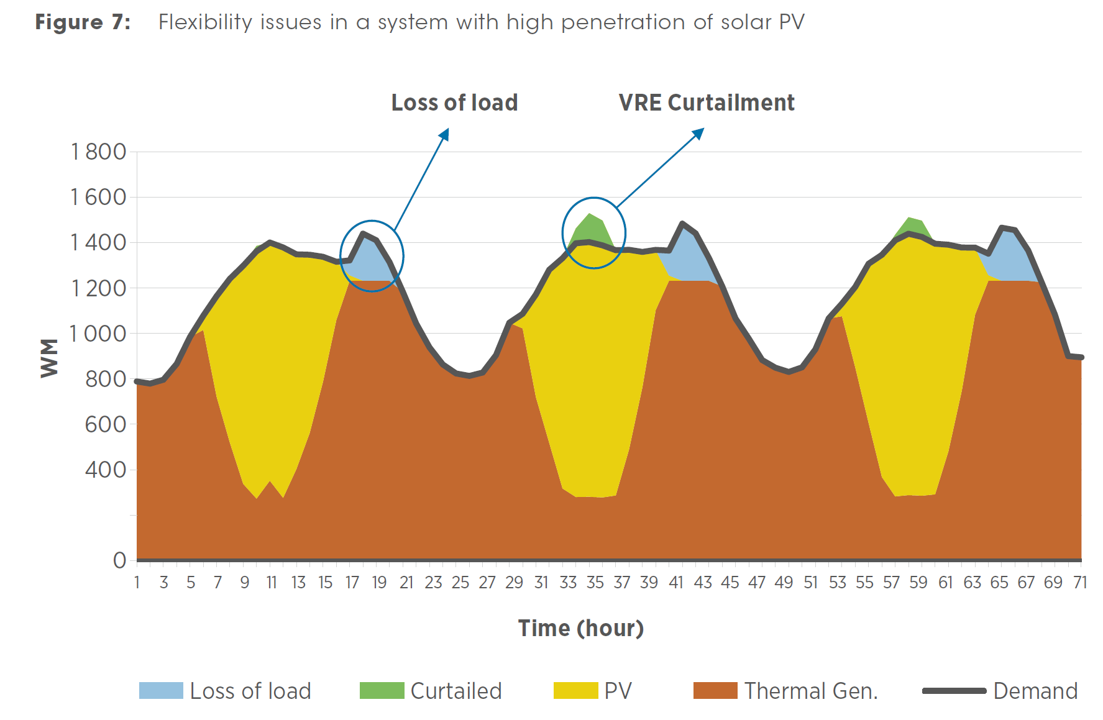
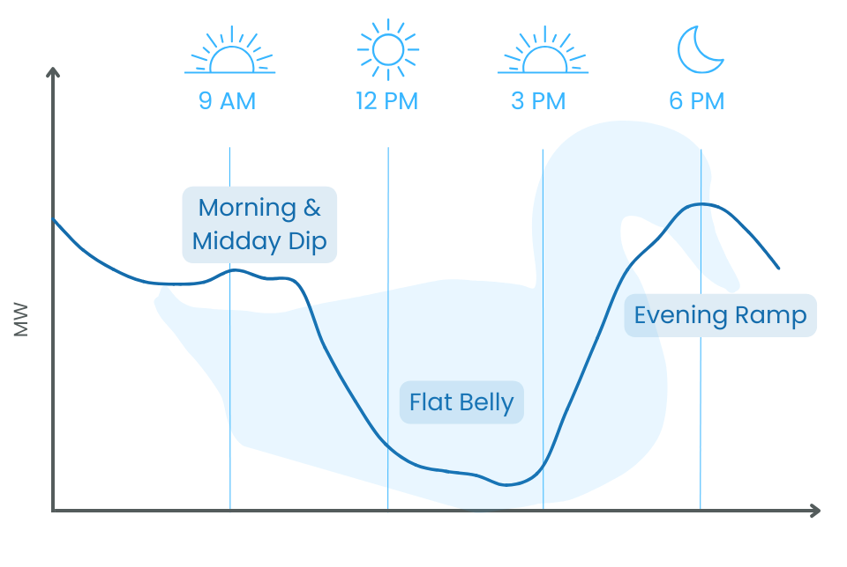
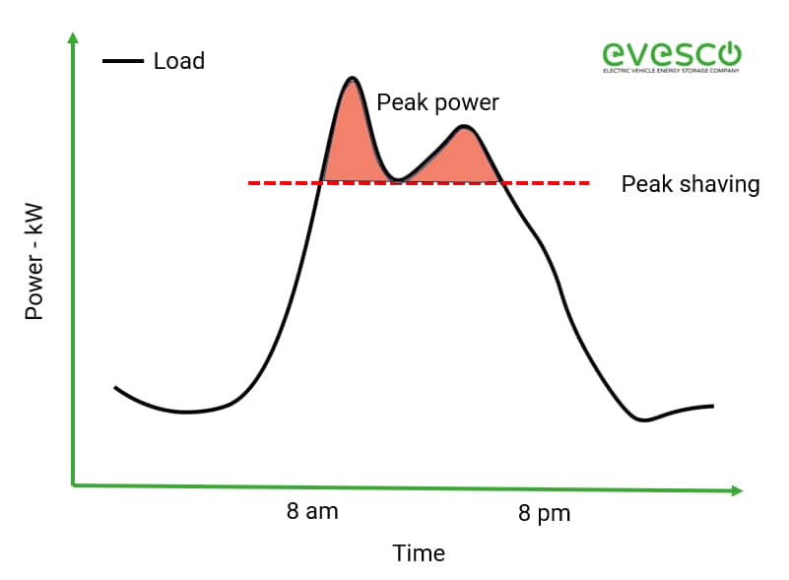
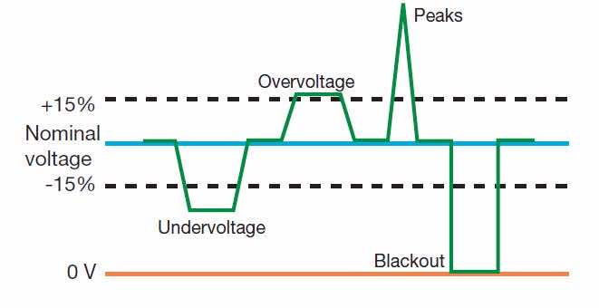
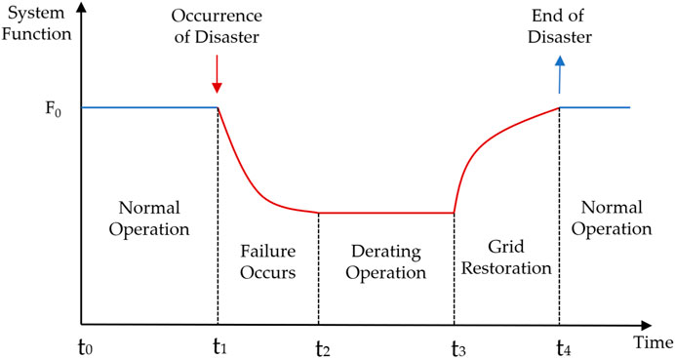
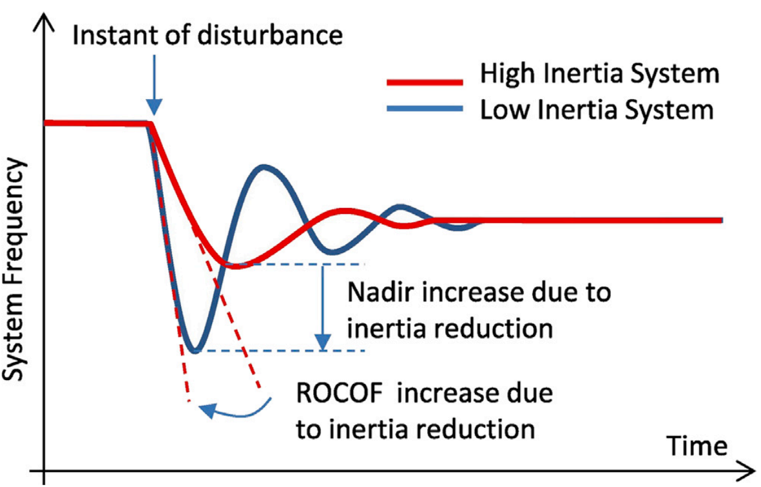
a
c
e
Power balancing
Load ramping
Congestion management
Gas
Wind farm
Hydropower
Charging station
Solar farm
End-user
Heat pump
Natural gas
Green hydrogen
Power network
Combined heat and power
District heat
Gas network
Voltage regulation
Resilience enhancement
d
f
b
Frequency response

Slide 14
Gas
Wind farm
Hydropower
Power network
charging station
Solar farm
End-user
Heat pump
natural gas
Combined heat and power
Gas network
District heat

Slide 15




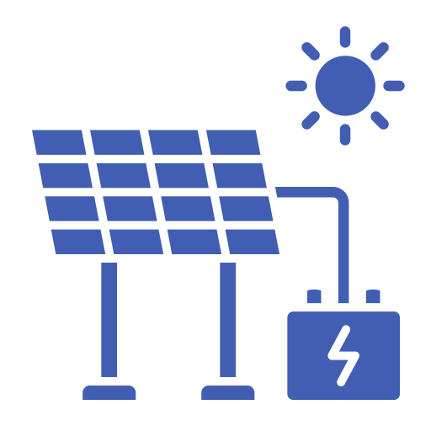




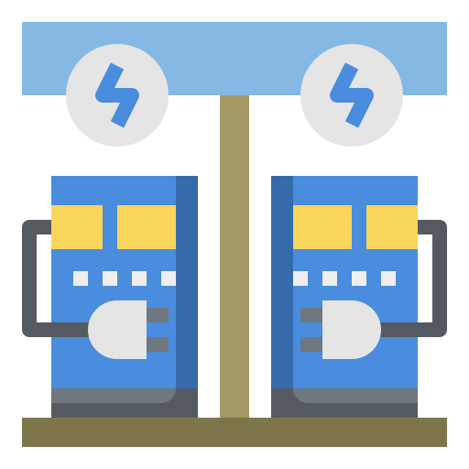
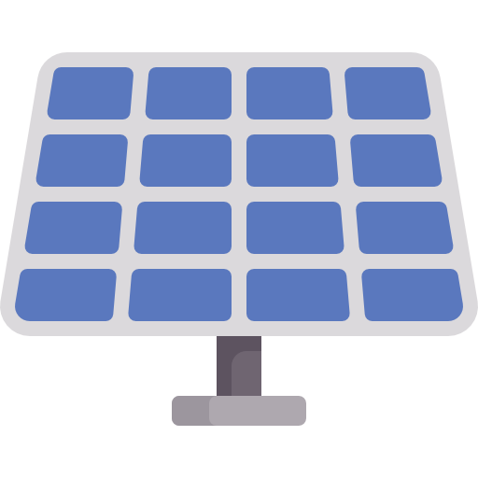
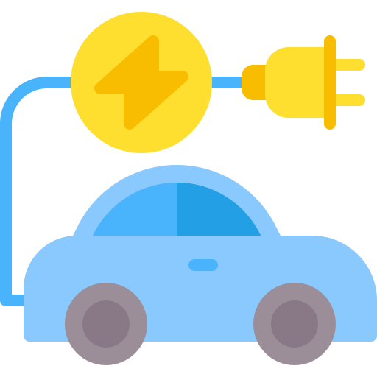

Interconnector
Gas
Wind
Interconnector
Hydropower
Power plants
Hydropower
Industry & Building
Transmission network
Clean natural gas
Pumped
hydro storage
Distribution network
Home
Electrolyser
H2 Storage
Charging station
Power-to-gas
Heat pump
Biomass
Flexible nuclear
Solar
Battery storage
Combined heat and power
Gas network

Slide 16

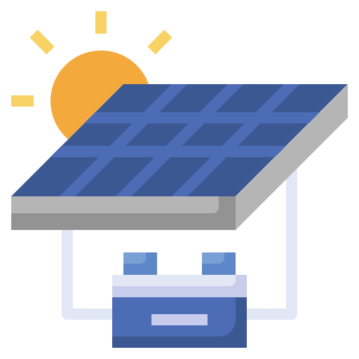
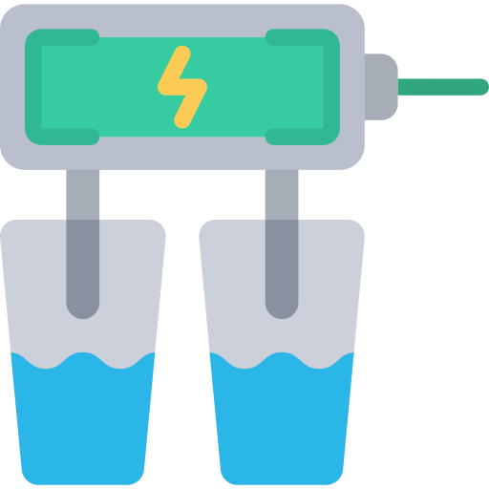


Gas
Interconnector
Wind farms
Hydropower
Power plants
Industry & Building
Transmission network
Distribution network
Home
Solar farms
Charging station
Heat pump
Gas network

Slide 17
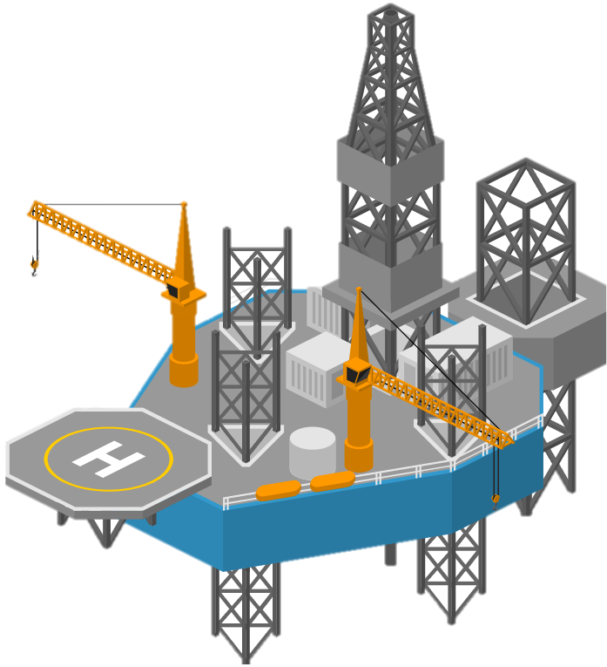
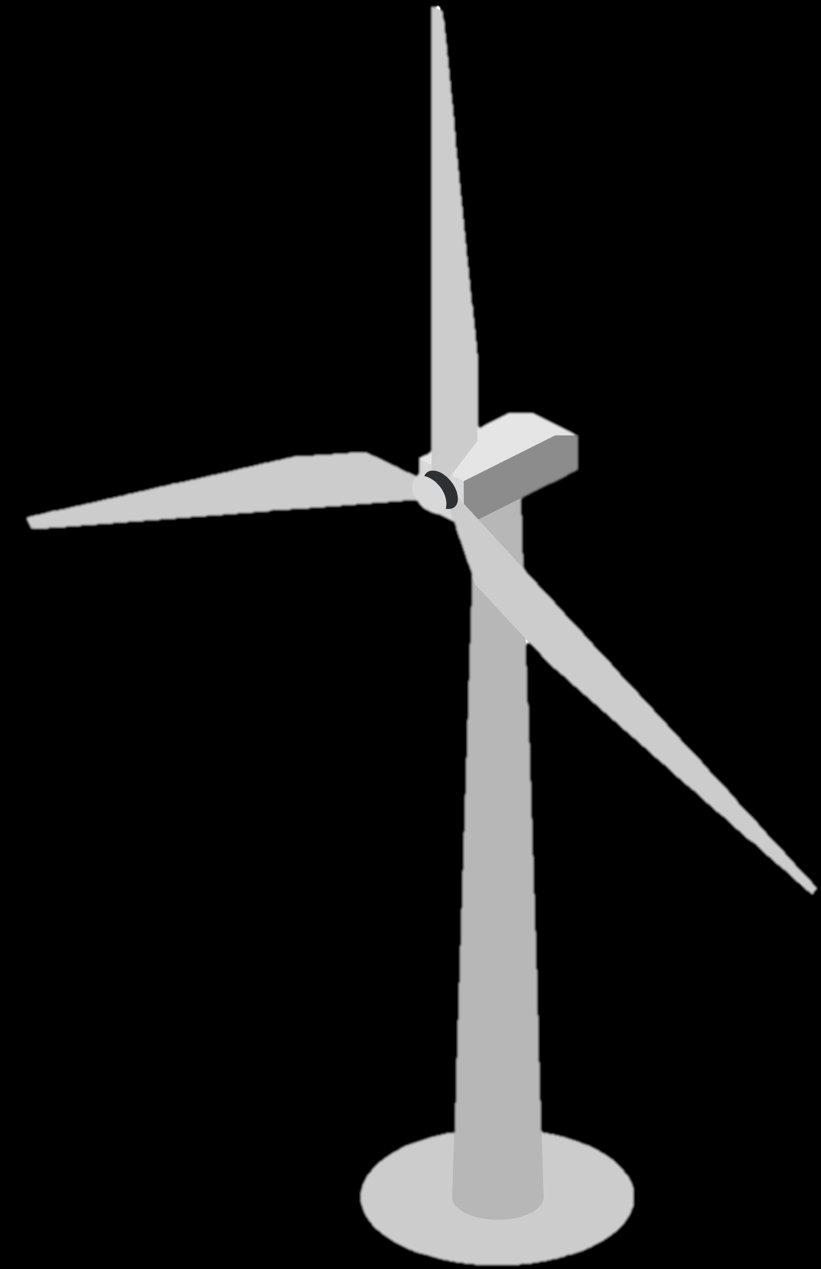

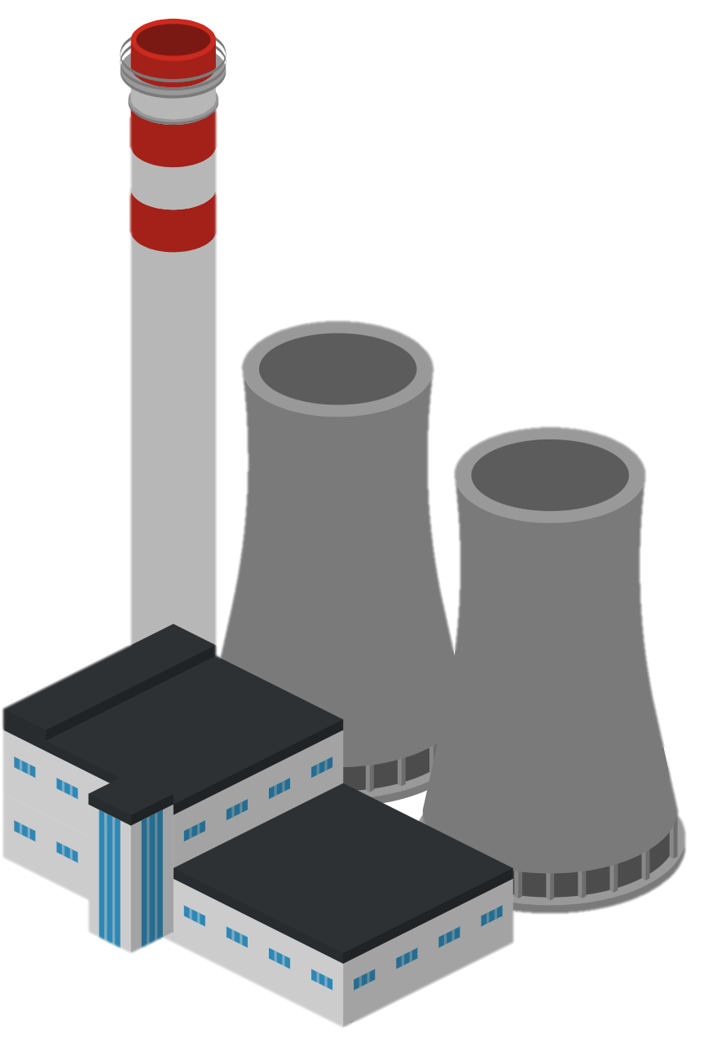

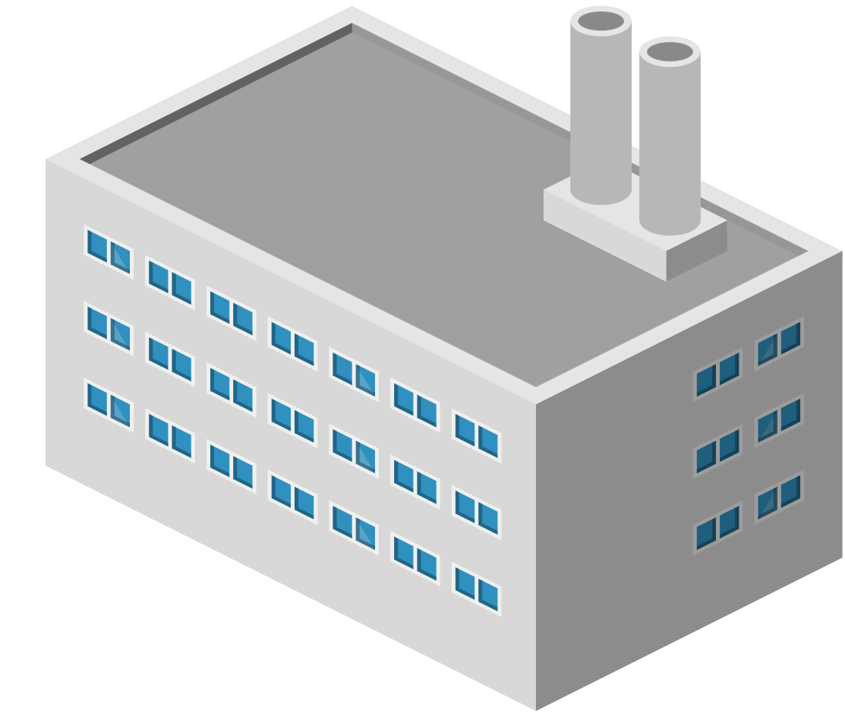

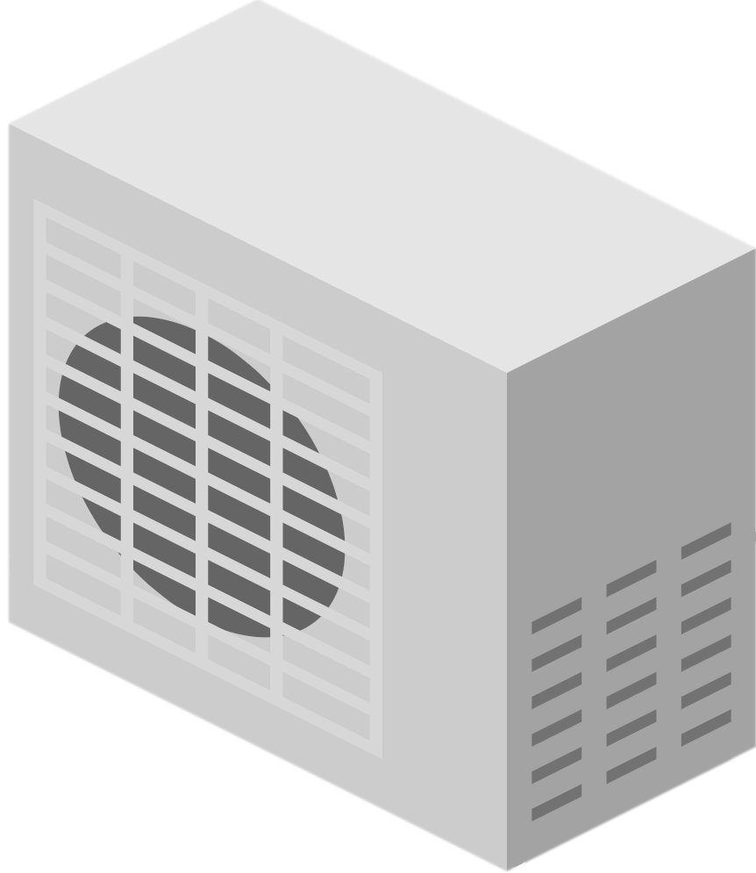

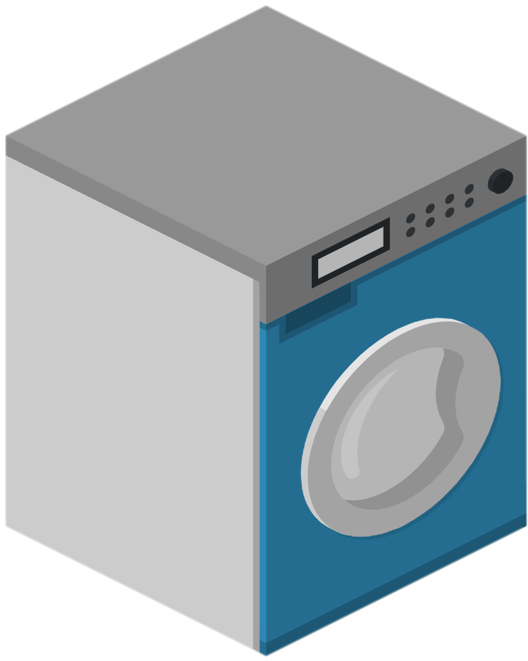
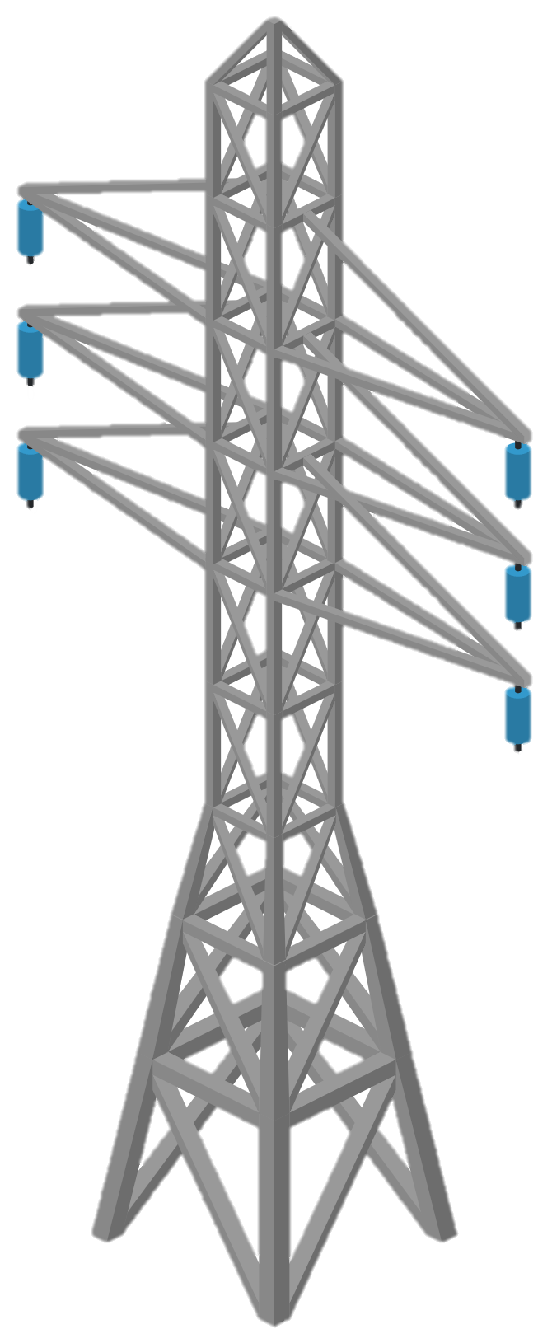
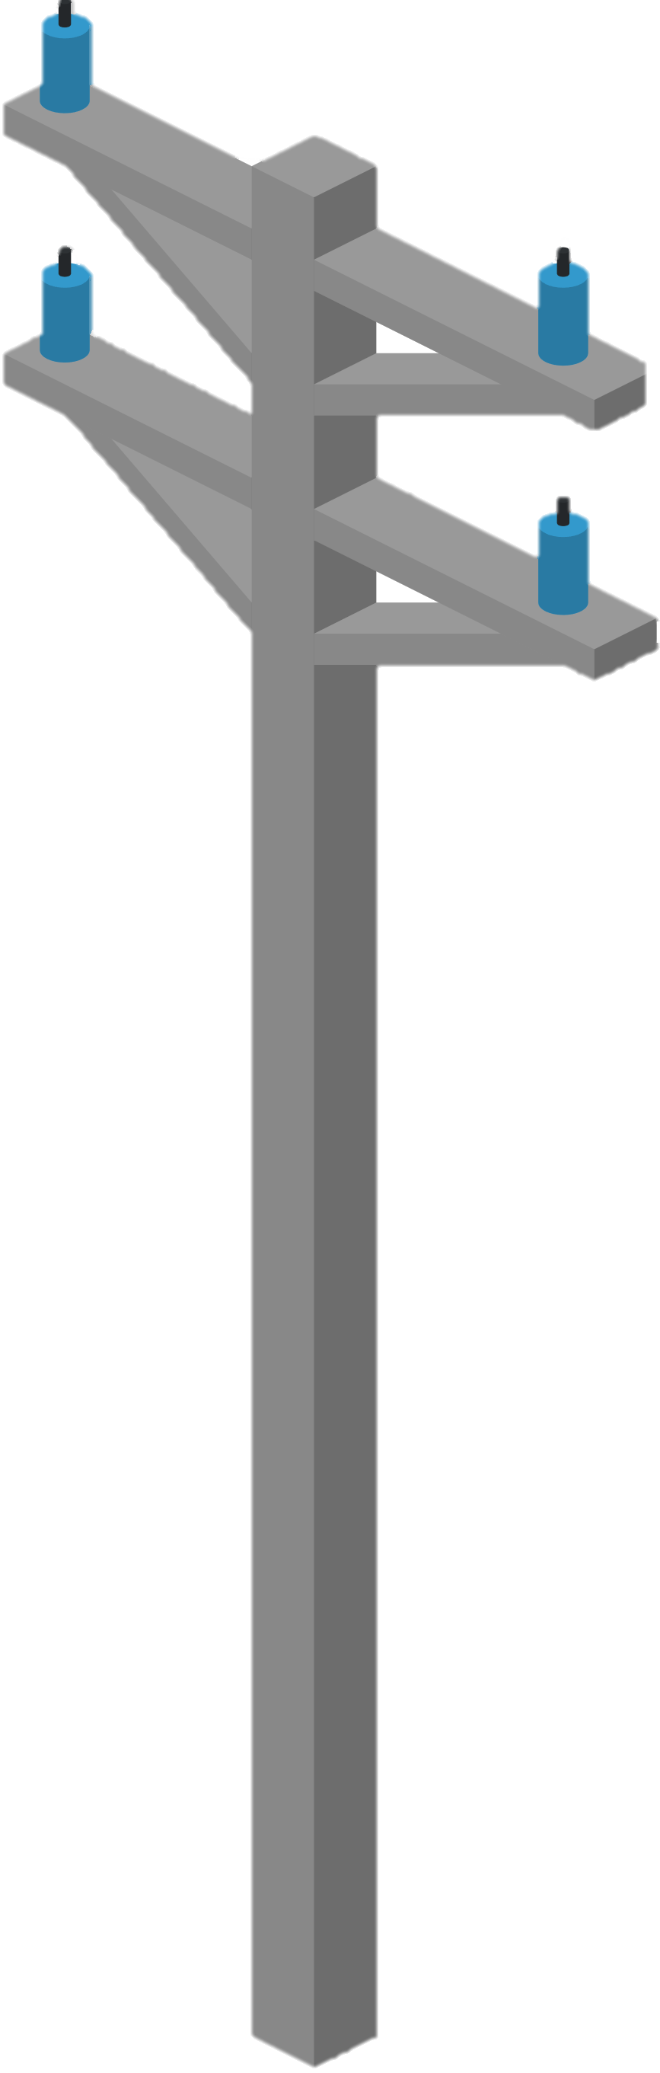
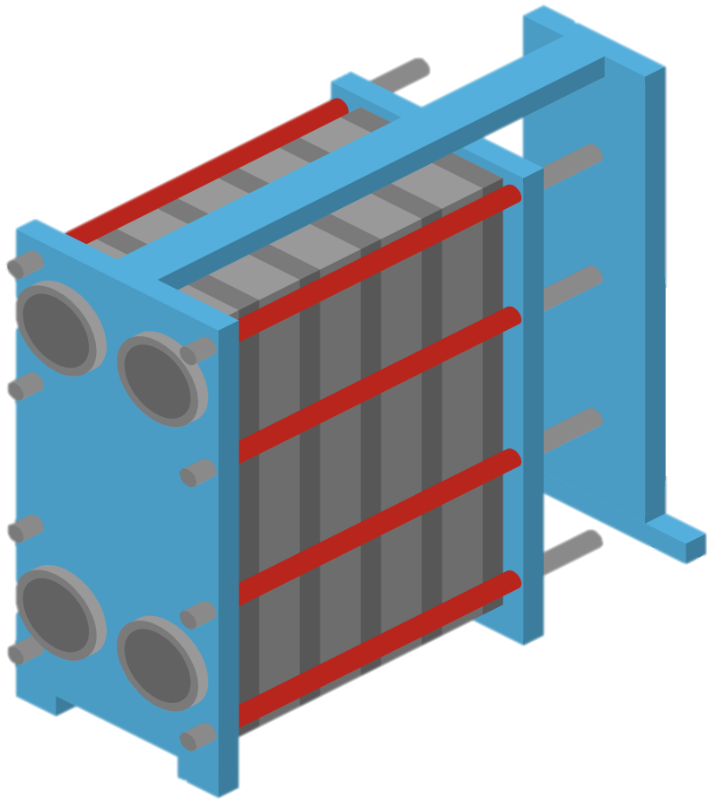

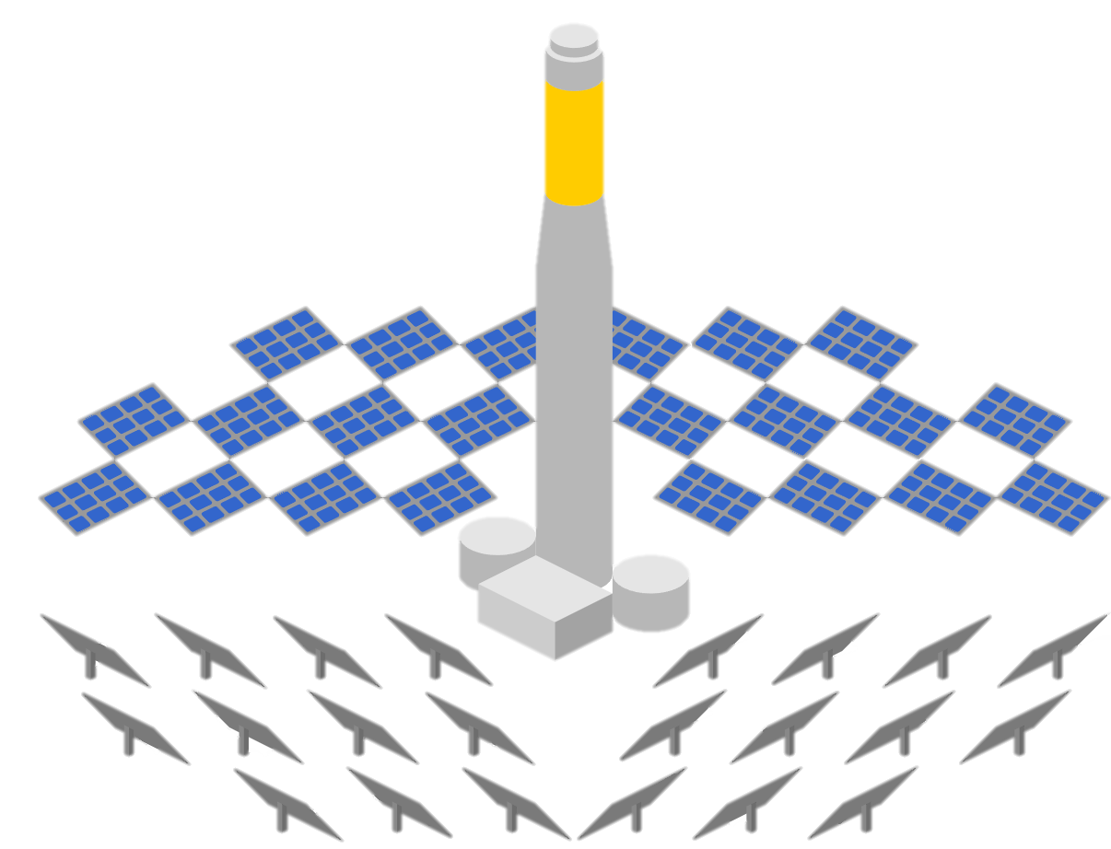
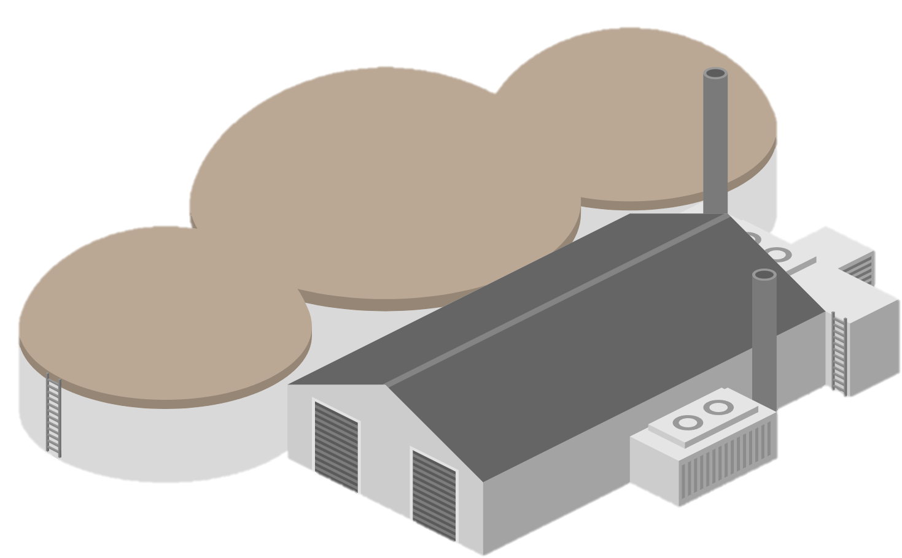


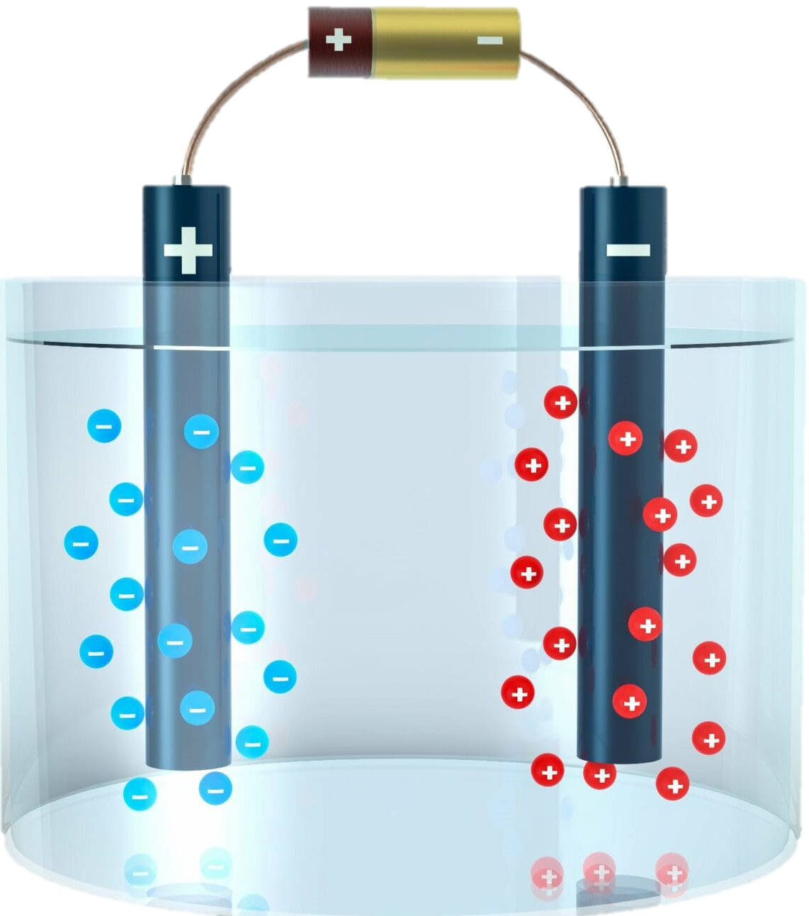

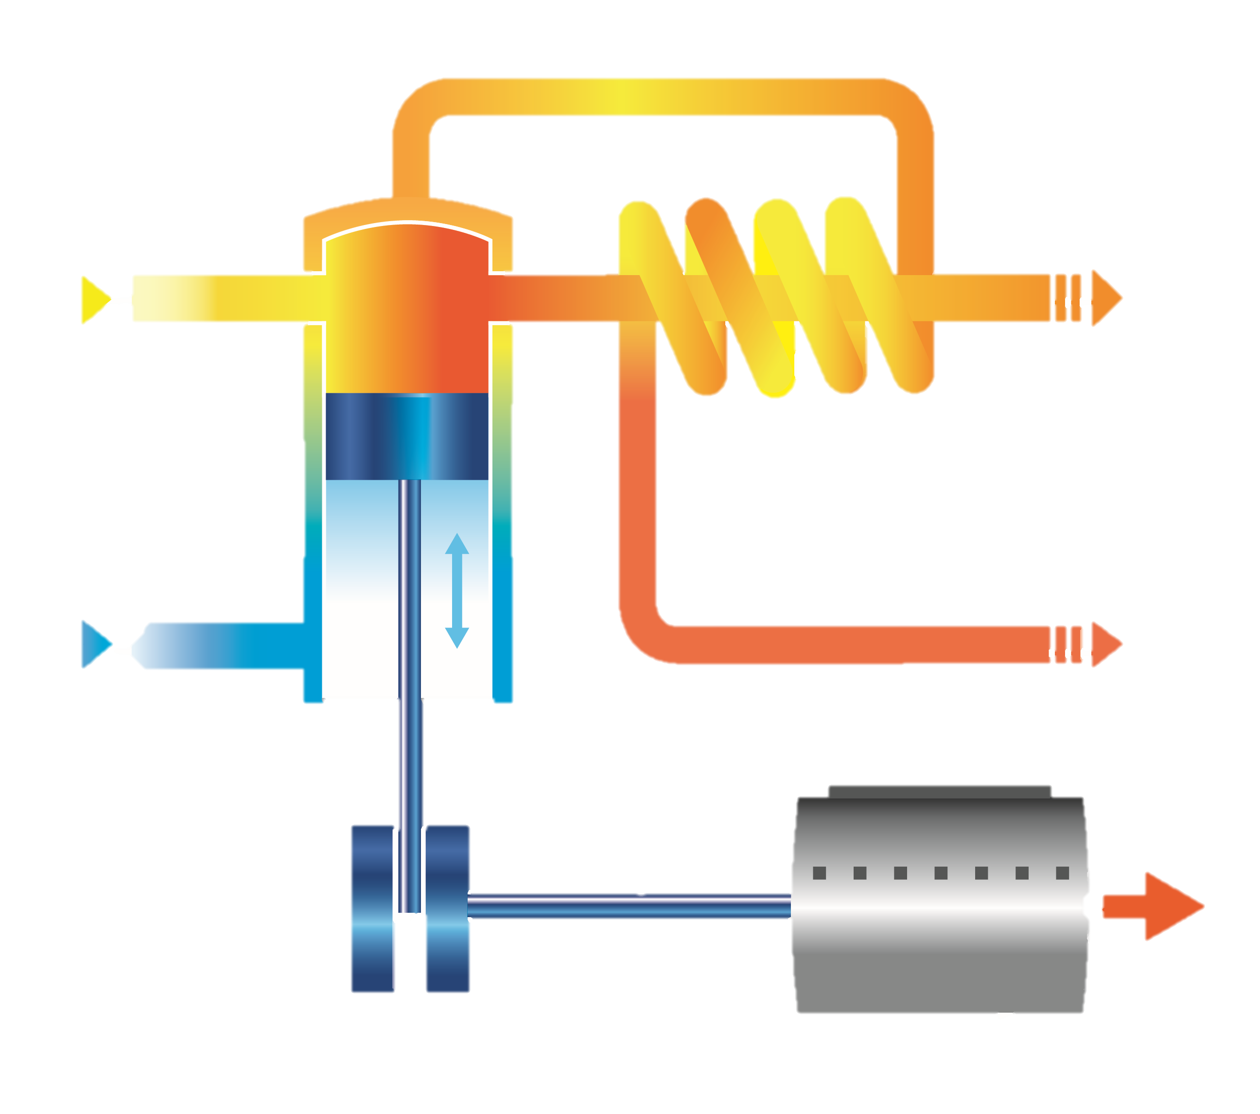


Gas
Wind farms
Hydropower
Interconnector
Industry & Building
HVAC
CO2
Pumped
hydro storage
Transmission network
Distribution network
Smart appliance
Home
Clean
natural gas
Heat pump
Thermal
storage
Battery
storage
H2 Storage
Solar farms
Biomass
Flexible
nuclear
Smart charging
Electrolyser
Power-to-gas
Combined heat and power
H2
Gas network
Linepack storage

Slide 18

Gas
Wind farms
Hydropower
Interconnector
Industry & Building
Home
Charging station
Power plants
Transmission network
Distribution network
Heat pump
Solar farms
Gas network

Slide 19
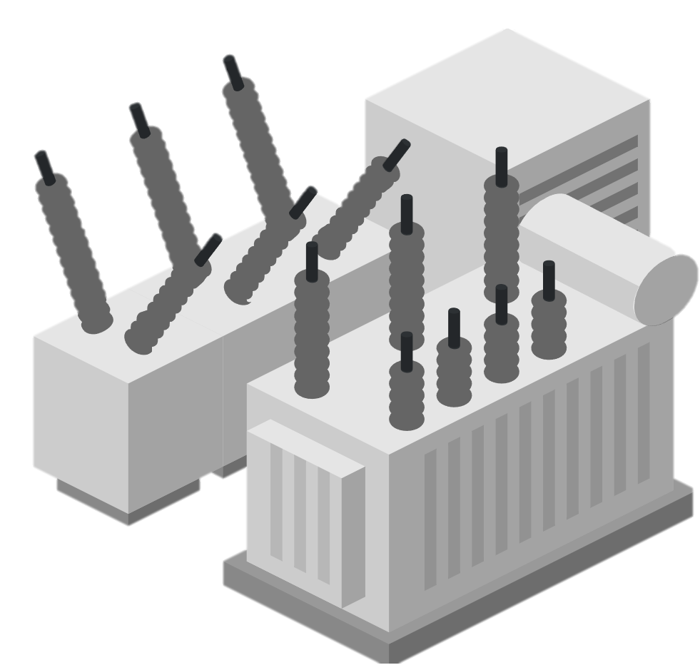
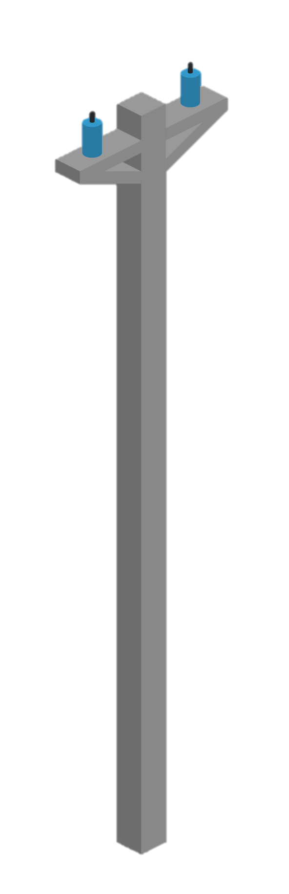

Wind farms
Transmission network
Distribution network
Charging station
Solar farms
Power lants
Residential load
Transformer
Substation
Commercial load
Industrial load

Slide 20
Gas
Wind farms
Hydropower
Interconnector
Industrial & Commercial load
Residential load
Power plants
Transmission network
Distribution network
Heat pump
Charging station
Solar farms
Gas network

Slide 21
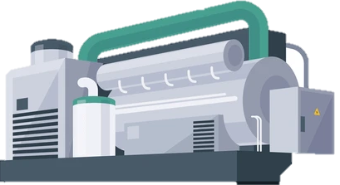
a
d
V2G
Power (GW)
Power (kW)
Demand
Charging
6
Solar
Arrive home
0
12
18
24
6
12
18
24
6
Clean dispatchable generation
Demand-side response
b
Storage+
Storage-
c
Line capacity
e
Power (GW)
Power (GW)
Flexibility availability
Power (GW)
Wind
Power flow
Day1
Day2
Day3
0
6
12
18
24
0
6
12
18
24
Large-scale electricity storage
Grid interconnector
Thermal energy storage
Gas
Wind farm
Interconnector
Carbon capture
Smart charging
Solar farm
Hydropower
Pumped
hydro storage
Clean natural gas
Demand response
Flexible nuclear
Power network
Heat pump
Battery storage
Biomass
Power-to-X
H2 Storage
Combined
heat and power
District heat
Thermal
energy storage
Gas network
Linepack storage
Power-to-hydrogen
Combine heat and power
Linkpack storage
f
Shift
g
h
Power (GW)
Excess
Shortage
Power (MW)
Performance
Demand
Solar power
Winter
Summer
Winter
t1
t2
t3
t4

Slide 22




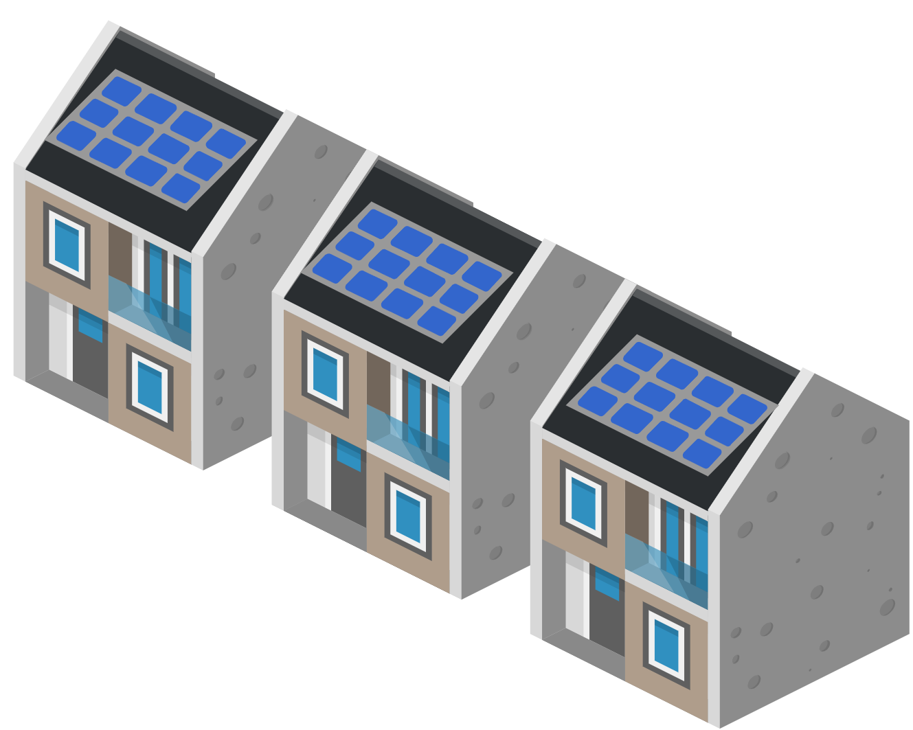


Slide 23
a
d
V2G
Power (GW)
Power (kW)
Demand
Charging
6
Solar
Arrive home
0
12
18
24
6
12
18
24
6
Clean dispatchable generation
Demand-side response
b
Storage+
Storage-
c
Line capacity
e
Power (GW)
Power (GW)
Flexibility availability
Power (GW)
Wind
Power flow
Day1
Day2
Day3
0
6
12
18
24
0
6
12
18
24
Large-scale electricity storage
Grid interconnector
Thermal energy storage
Gas
Wind farm
Interconnector
Carbon capture
Smart charging
Solar farm
Hydropower
Pumped
hydro storage
Clean natural gas
Demand response
Flexible nuclear
Power network
Heat pump
Battery storage
Biomass
Power-to-X
H2 Storage
Combined
heat and power
District heat
Thermal
energy storage
Gas network
Linepack storage
Power-to-hydrogen
Combine heat and power
Linkpack storage
f
Shift
g
Heat
Load duration
h
Power (GW)
Excess
Shortage
H2
Load (%)
Baseload
Performance
Demand
Hours
(year)
Solar power
Loss
Elec.
Winter
Summer
Winter
t1
t2
t3
t4

